Slide 1
Intro to AI for Medicine
Lec 3: Loss Functions

Slide 2
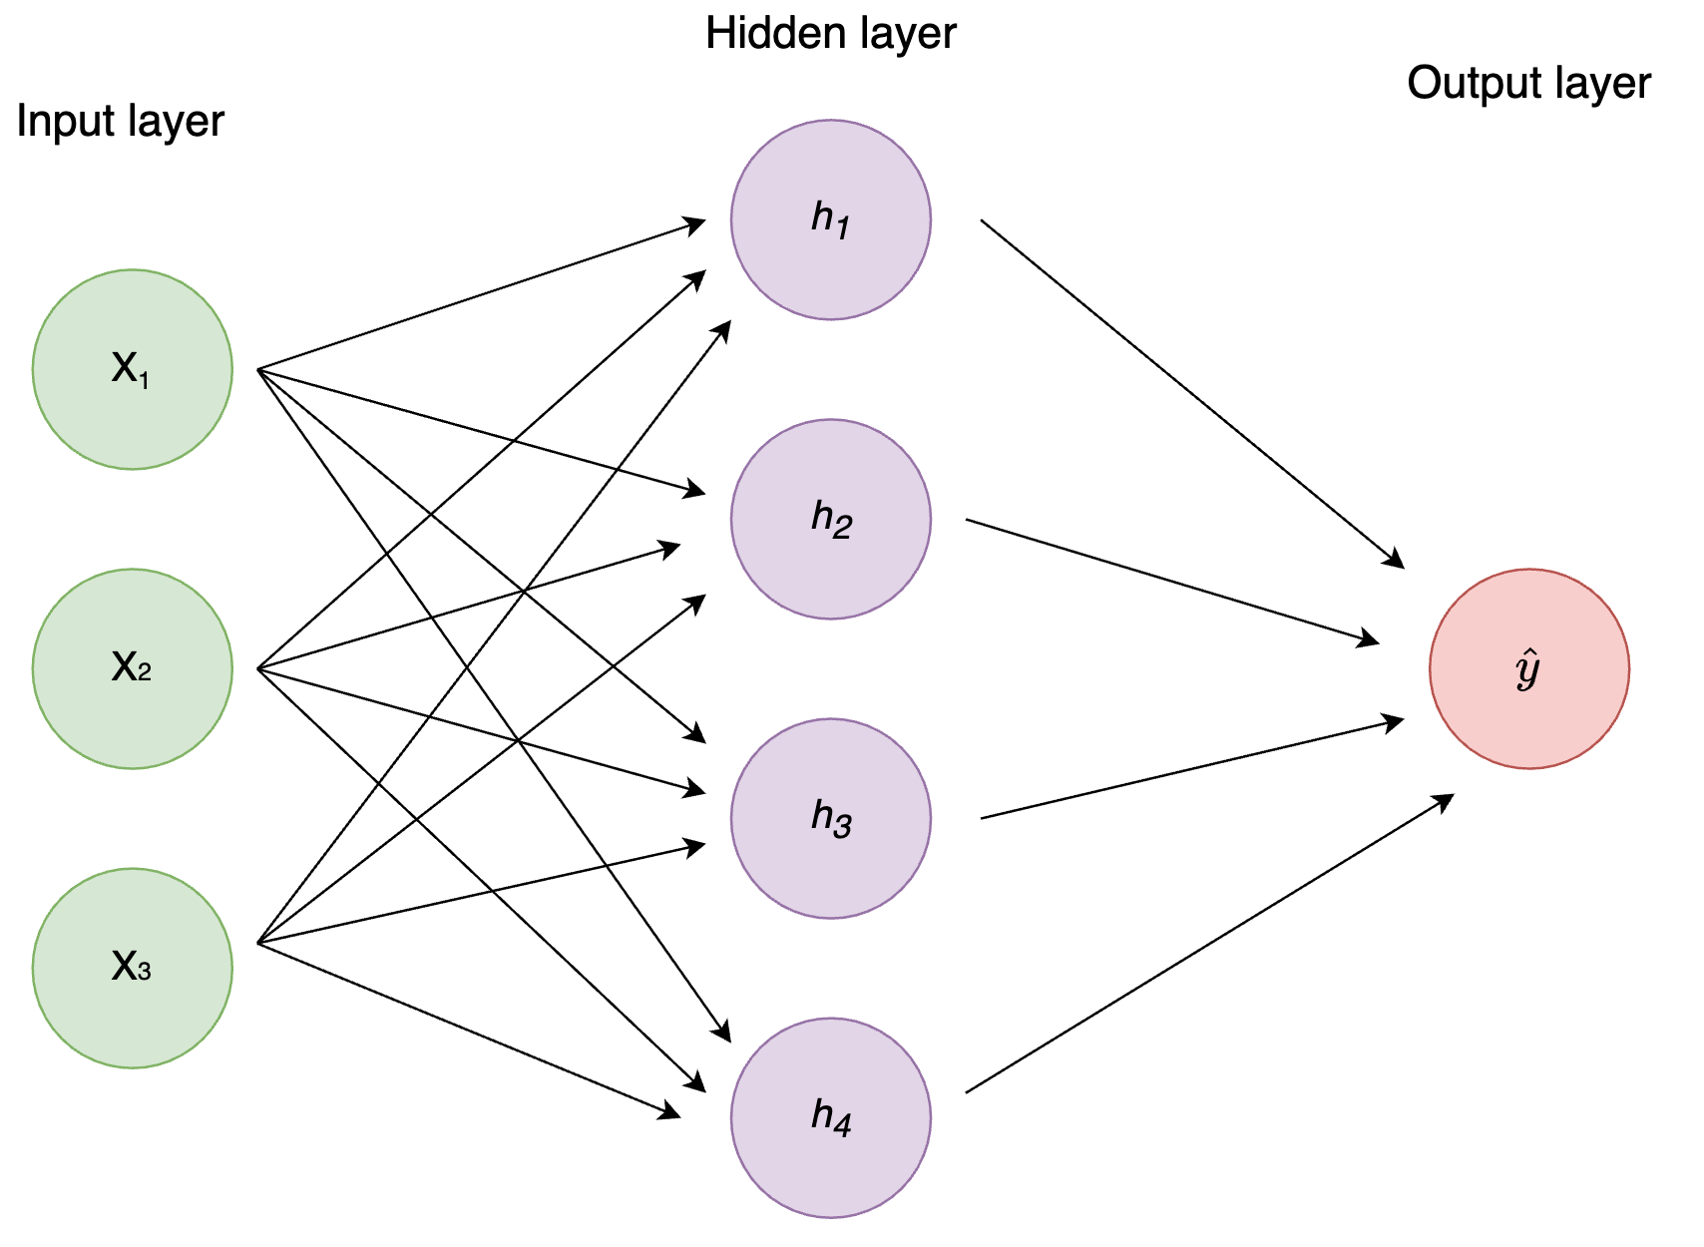
Last Time
Learned about matrices
Defined the neural net
Learned how we use the neural net to update matrices

Slide 3
Agenda
Define loss function
Linear regression
How we change that to multidimensional regression of any function
Mean Squared Error Loss
Classification Intro
Log Loss
Classification Case Study
ML model evaluation metrics (mostly review)
Multi-Class Classification

Slide 4
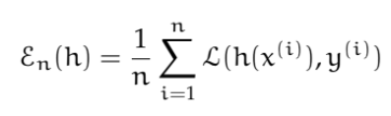
Loss Functions
How do we grade our results?
Use a loss function!
Loss function: Definition of correctness, which when applied over the data, decreases when the hypotheses are more correct
Training error is the sum of loss across all data points.
Notes:
Turns out, there’s a way to cheat linear regression and spit out the answer, so it’s not used in practice.
However, MSE makes sense in any problem context which has n

Slide 5
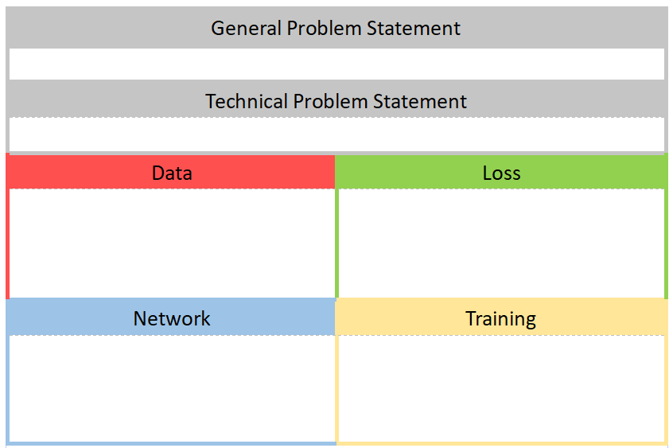
This time
We learn how to define success via loss functions

Slide 6
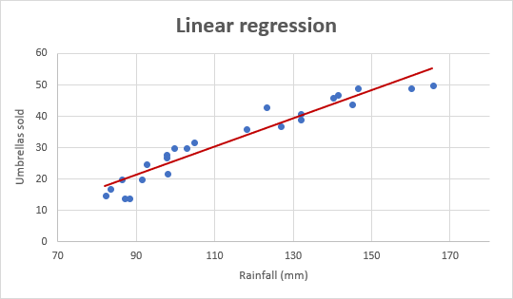
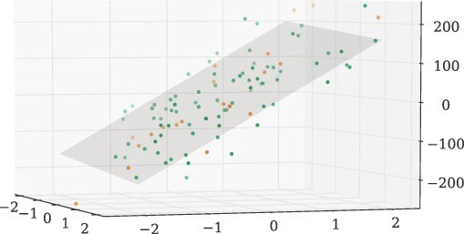
What is Linear Regression?
Find a linear function that best models the relationship between inputs and outputs
Notes:
Of course, this is rarely the case in real life, but a good illustrative example of how we can use gradient descent.
Can be 1d or multiple dimensional input.
This is 3d case but many dimensional input is possible. That is, many inputs, predict one output variable.

Slide 7

Linear Regression: Problem
Given an input matrix x, an output matrix y, use x to predict y.
Goal
$$\left[\begin{matrix}\begin{matrix}x1 & x2\end{matrix} & \begin{matrix}... & xn\end{matrix}\end{matrix}\right]→\left[\begin{matrix}\begin{matrix}y1 & y2\end{matrix} & \begin{matrix}... & yn\end{matrix}\end{matrix}\right]$$
Plan
$$\left[\begin{matrix}\begin{matrix}x1 & x2\end{matrix} & \begin{matrix}... & xn\end{matrix}\end{matrix}\right]→\left[\begin{matrix}\begin{matrix}\text{ŷ}1 & \text{ŷ}2\end{matrix} & \begin{matrix}... & \text{ŷ}n\end{matrix}\end{matrix}\right]$$
Notes:
Goal is to predict the data that we’re passed in with.
What we do is generate hypotheses – and see how we did.
Note, this is the 1d case.

Slide 8
Linear Regression: Plan
Take in an input
Multiply it by a constant weight
Or each part of the input by its own weight, if input has multiple parts/dimensions
See how we did
Update our weights
Repeat
Notes:
In the vein of backpropagation to update weights
We’ll see how we did via our loss function

Slide 9
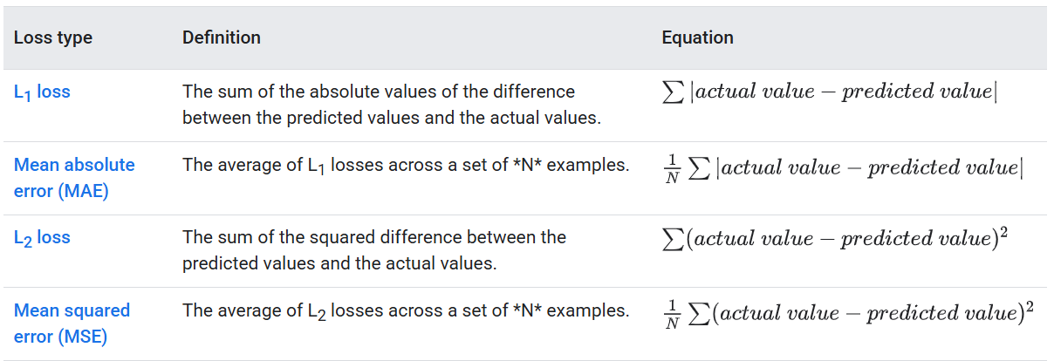
Loss Types

Slide 10
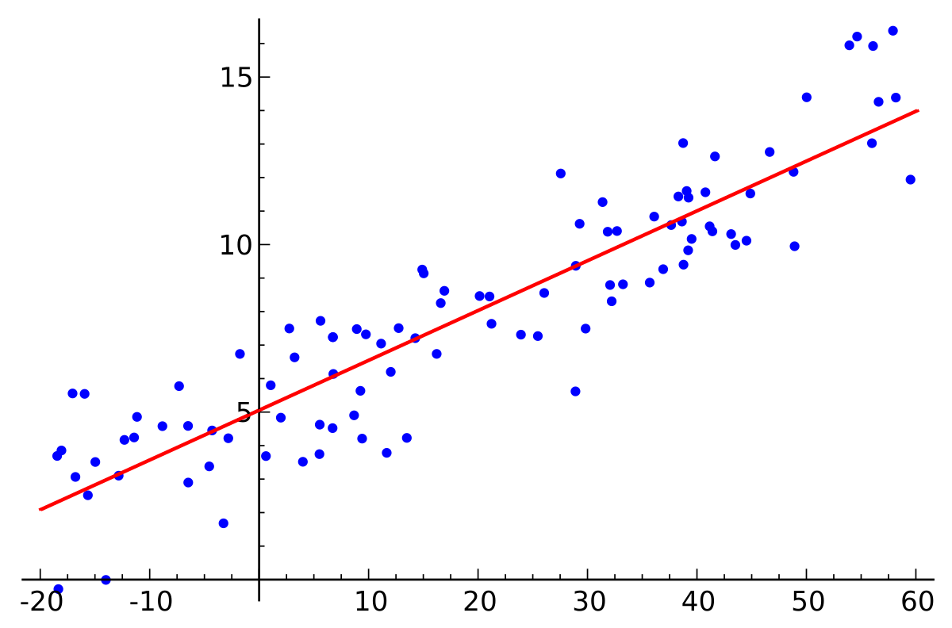

1D Input Case
$$y=m∗x+b$$
Notes:
Can anyone tell me how I can describe this line? What equation would I use
We have a weight, and an offset

Slide 11

1D input Case
$$\text{ŷ} =m∗x+b$$
Notes:
Y hat next slide

Slide 12
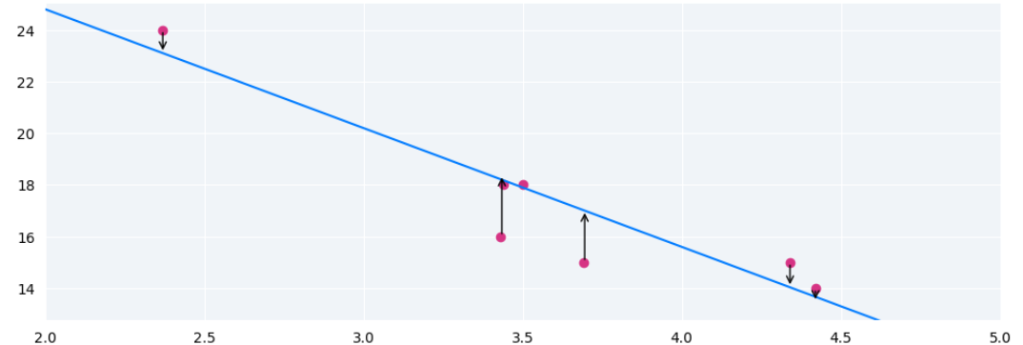
Loss Functions: Visualized
Notes:
This is what loss looks like datapoint by datapoint.
It’s the error between our prediction and our actual.
This is absolute error

Slide 13
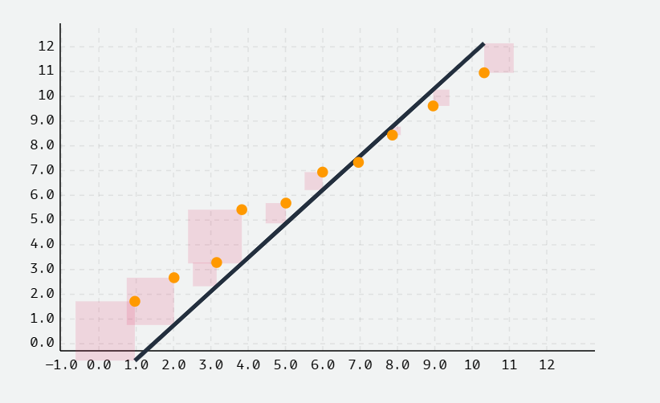
Loss Functions: Visualized
Notes:
This is MSE from the homework. Look at the squares, which indicate the amount of error. Far points give us lots of error

Slide 14
Linear Regression: Problem
InfantID | Cigarettes_per_day (during pregnancy) | BirthWeight (grams)
001 | 0 | 3500
002 | 5 | 3300
003 | 10 | 3150
004 | 0 | 3600
005 | 15 | 3000
006 | 20 | 2850
007 | 0 | 3400
008 | 25 | 2750
009 | 12 | 3100
010 | 0 | 3550
Notes:
Here’s an example dataset. We’re using cigarettes per day during pregnancy to predict birth weight.

Slide 15
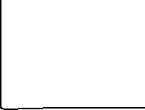
Linear Regression: Intuition
InfantID | Cigarettes_per_day (during pregnancy) | BirthWeight (grams) | Predictions | Difference | Squared Error
001 | 0 | 3500 | 3000 | 500 | 250000
002 | 5 | 3300 | 3250 | 50 | 2500
003 | 10 | 3150 | 3500 | -350 | 122500
 |  |  |  |  | 385000
Weight=250*cigarettes+3000
Imagine if our prediction was exact – error contribution for that point is 0
So, lower is better which matches gradient descent objective.
Weight
Cigarettes
Notes:
1. Func 2. talking points
Let’s say our linear regression function chose these to start.
Let’s compute our MSE for each data point.
We can see loss is kinda like a scoring system – lower is always better

Slide 16

Gradient Descent
Algorithm:
Find gradient at start point
Move opposite that direction by an amount = gradient magnitude times a constant (learning rate)
Repeat until the value between steps changes less than a set amount (or a fixed number of times)
Notes:
Recall our gradient descent function – we’ll update m and b in y=mx+b to be better by updating them in a way that decreases mean squared error. Backpropagation informs us what updates should be made. Now, let’s try again.

Slide 17
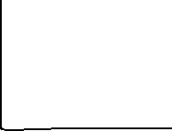
Linear Regression: Intuition
InfantID | Cigarettes_per_day (during pregnancy) | BirthWeight (grams) | Predictions | Difference | Squared Error
001 | 0 | 3500 | 3250 | 250 | 62500
002 | 5 | 3300 | 3250 | 50 | 2500
003 | 10 | 3150 | 3250 | -350 | 10000
 |  |  |  |  | 75000
Weight=0*cigarettes+3000
Weight
Cigarettes
Notes:
So we know lower is better, which fits.
Things really far away get a big penalty – really bad predictions aren’t good so this is usually better in practice
This is a good aside to say that the way we design our function has a big impact on the way models result. Do we care a lot about things really far off, or not? Someti

Slide 18
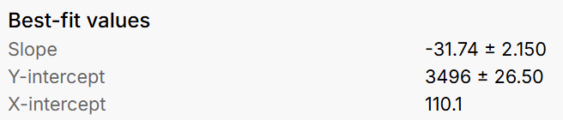
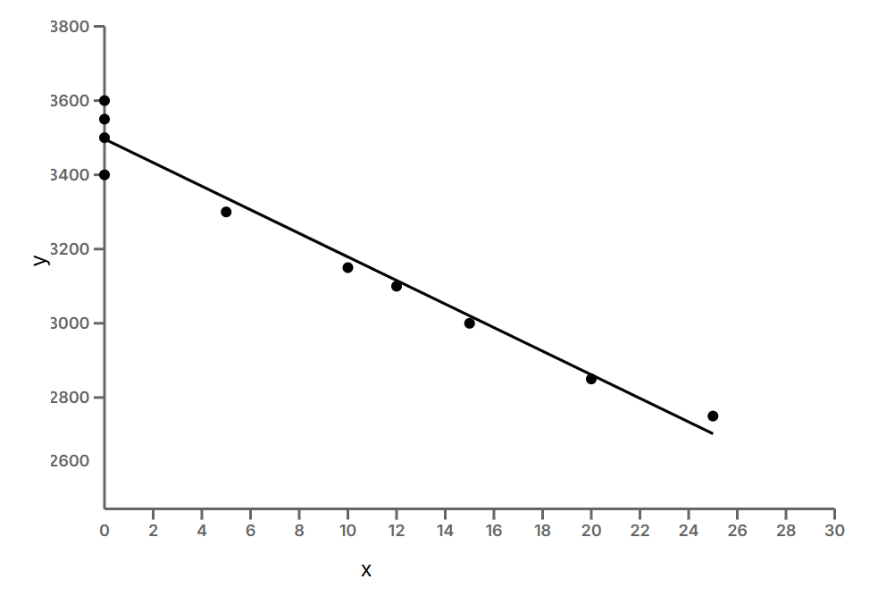
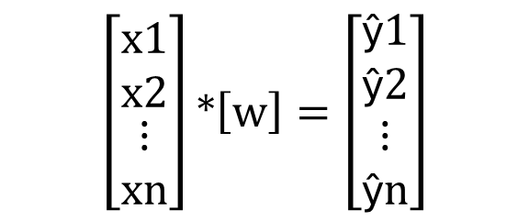
Linear Regression
$$\left[\begin{matrix}\begin{matrix}x1 \\ x2\end{matrix} \\ \begin{matrix}⋮ \\ xn\end{matrix}\end{matrix}\right]∗\left[w\right]=\left[\begin{matrix}\begin{matrix}\text{ŷ}1 \\ \text{ŷ}2\end{matrix} \\ \begin{matrix}⋮ \\ \text{ŷ}n\end{matrix}\end{matrix}\right]$$
Notes:
X axis – cigarettes/day during pregnancy
Y birthweight
So our x are the cigarettes from prior tab
W is our slope

Slide 19
Regression Summary
Solvable using ML
Mean squared error loss makes most sense for these problems
Numerical input and output
Big outliers are bad

Slide 20
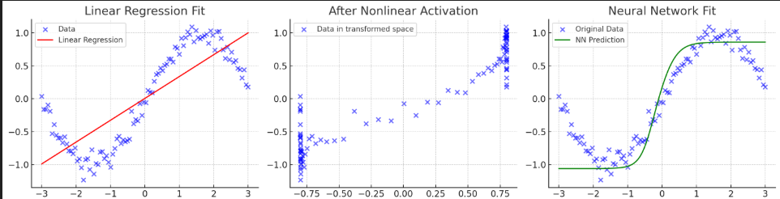
What if It’s Nonlinear?
Notes:
Left we see some data – clearly not linear in pattern.
If we train a neural network on it, we see the data is transformed to be more linear after one layer. We see one layer after hyperbolic tangent activation.
So, on the far right we see the predictions overlaid on our data – not linear!
So, the method we used with linear regression was successful when used in tandem with our NN.

Slide 21

A New Problem Statement
Let’s say we want to predict probability a patient has a disease.
We want to “classify” them into one of two categories.
So instead of a regression problem, we have a classification problem.
Notes:
Different than before when we wanted a quantitative output.
Being disease/no disease

Slide 22
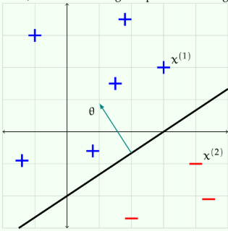
What Loss Function?
Binary Loss:
If on the correct side, 0
If on the wrong side, 1
Notes:
So here we have positives and negatives split by a decision boundary. Above the line we want all our positives, below we want our negatives.
What are some ideas for our loss? Binary loss?
Why is that a bad idea?

Slide 23
Binary Loss:
Binary Loss:
If on the correct side, 0
If on the wrong side, 1
Loss = 1
Loss = 1
Notes:
Let’s say the green line is our decision boundary
Which of these is better?
According to binary loss, what’s our loss in each case?

Slide 24
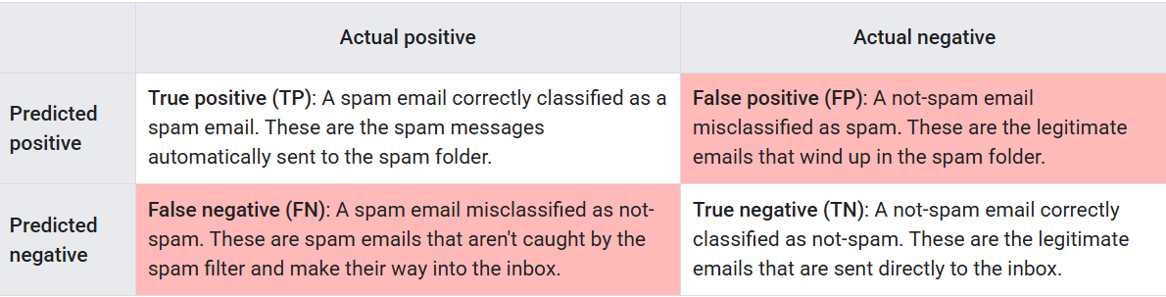
We already know this!
Confusion matrix

Slide 25
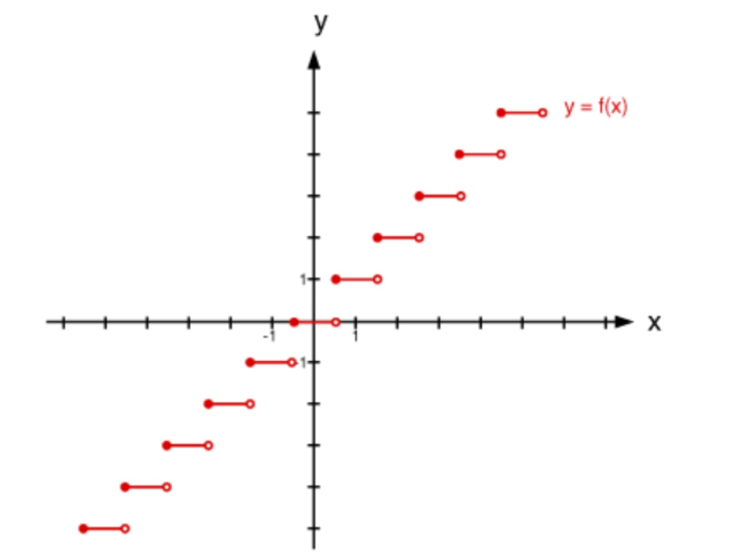
Binary Loss Surface
Notes:
It looks like a step function.
What’s the issue with this?
How can we run gradient descent here? We can’t.

Slide 26
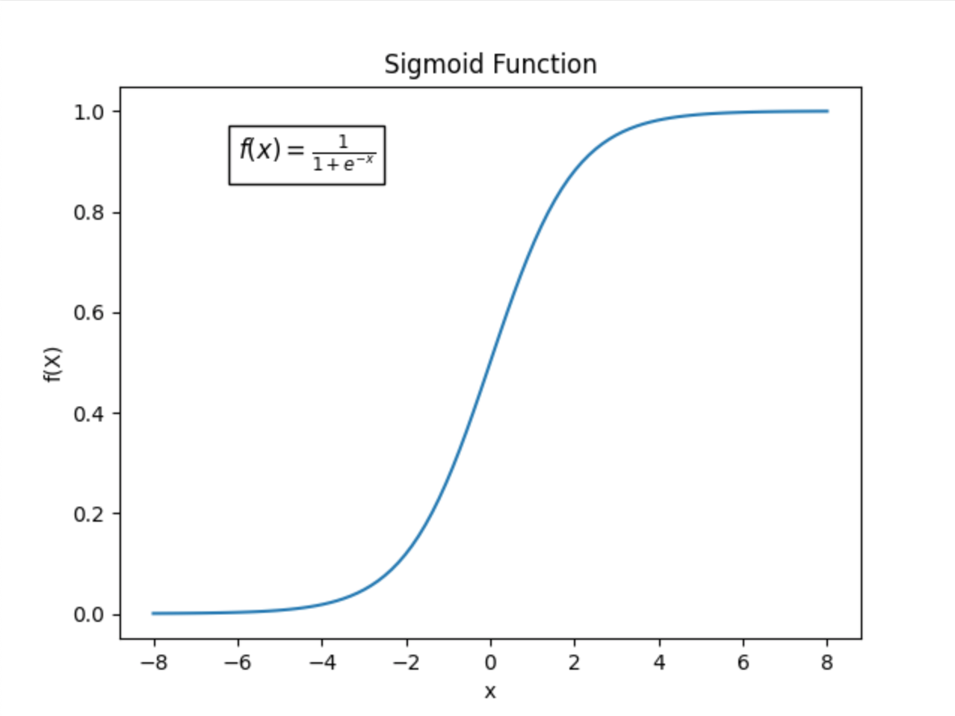


Sigmoid and Log Loss
Notes:
We start by changing our function’s goal to generating a probability that we’re in the right class. In other words, how sure are we.
So we put our output in the sigmoid.
If we’re sure it’s in the positive class (above line), we have a bigger z, so e^-z goes to 0 and our denominator goes to 1 and whole thing is 1
If we’re sure it’s in the negative class (below line), then e^-z goes to infinity, denominator goes to infinity and output is 1.

Slide 27
Log Likelihood Loss
Recall:
Log(0) -> negative infinity
Log(1) = 0
Guess | Actual | Loss
0.00001 | 0 | 0
1 | 0 | infinity
1 | 1 | 0
0.00001 | 1 | infinity
.5 | 1 | .301
.75 | 1 | .125
Notes:
So, low loss if we are very sure and right. Medium loss if we’re kinda sure and right. High loss if we’re wrong with conviction.
Case 1: essentially 1*log(1). Aka 0.
Don’t forget negative sign in front. Notice how side that isn’t the guess multiplies to zero.

Slide 28
Log Likelihood Loss
Note: often called cross-entropy loss!
Recall:
Log(0) -> negative infinity
Log(1) = 0
Guess | Actual | Loss
0.00001 | 0 | 0
1 | 0 | infinity
1 | 1 | 0
0.00001 | 1 | infinity
.5 | 1 | .301
.75 | 1 | .125
Notes:
Think about it, our loss mathematically has meaning. What we’re trying to achieve has to be in line with our loss function. So this is why understanding loss is key. It tells you how we define success in our system and has to match our problem statement.

Slide 29
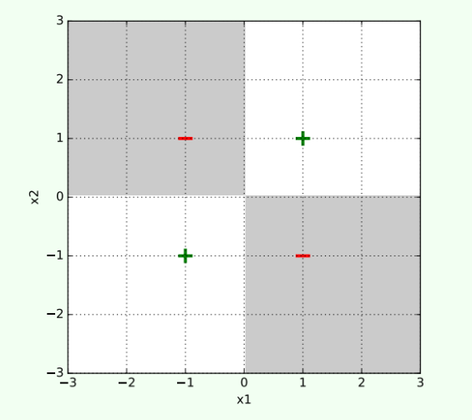
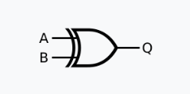
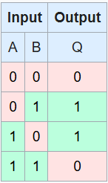
What if we can’t separate?
XOR
Notes:
Those with good memory will recall this is the XOR. The function that set ML back 20 years.
The answer is that we may not be able to classify here, but with transformations into a higher dimension, we can.

Slide 30
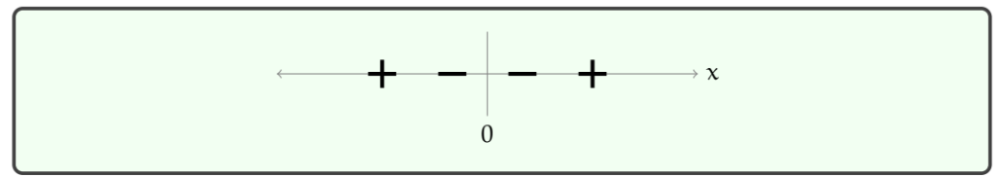
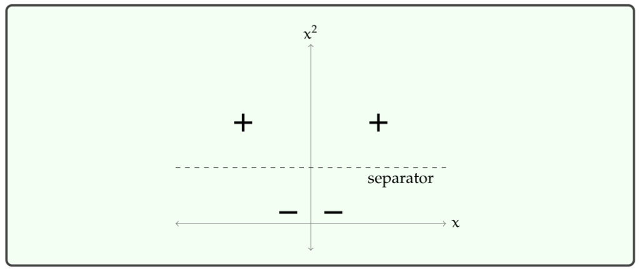


$$φ(x) = [x,x^{2}].$$
$$\left[\begin{matrix}w1 \\ w2\end{matrix}\right]\left[x\right]=\left[\begin{matrix}w1∗x \\ w2∗x\end{matrix}\right]$$
Then with activation for nonlinearity.
Notes:
Can you draw a separator here?
So in a higher dimension, we can do it.

Slide 31
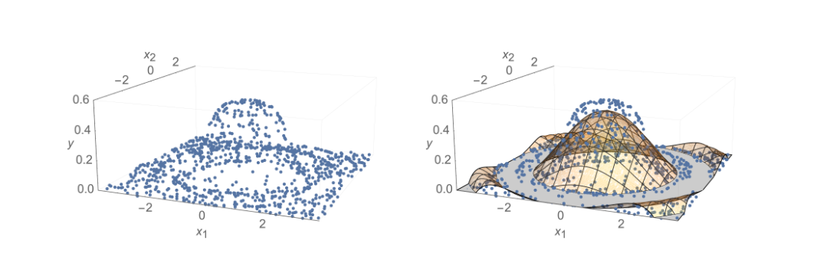
Notes:
What transformation to a higher dimensional plane looks like.
Gray plane is the separator.

Slide 32
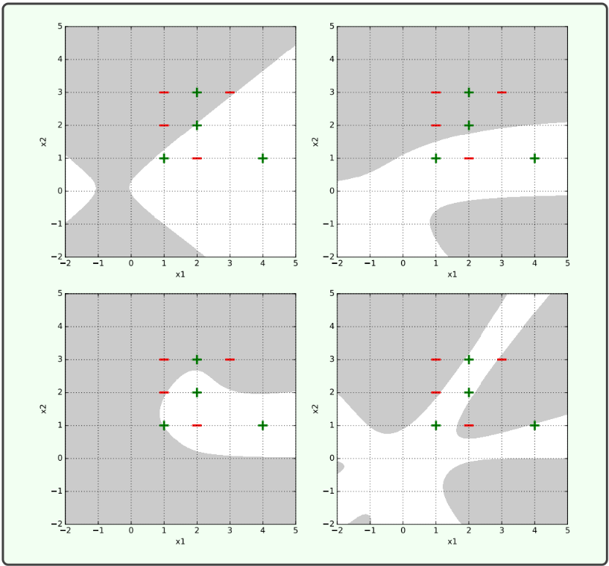
Notes:
Logistic regression with gradient descent failed to separate it
with a second, third, or fourth-order basis feature representation. Shown below are some
results after ∼ 1000 gradient descent iterations (from random starting points) for bases of
order 2, 3, 4, and 5.

Slide 33
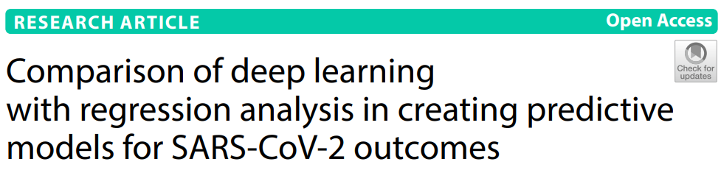
Case Study
Compares Deep Learning to regular statistical model (Cox Regression)
Aims to find those patients who are positive for Covid and will die while hospitalized

Slide 34
General Problem Statement
Predict whether or not a Covid + patient will die while hospitalized
Technical Problem Statement
Deep Learning based binary classification into survive/dead groups
Data | Loss
Predictors listed on next slide Lab diagnosis of COVID-19 in one SW London hospital Extracted from EHR via chart review (retrospective) | Lowest loss as measured by binary cross-entropy on the validation set. Appropriate for this problem
Network | Training
”Artificial Neural Network” Basically MLP/Fully connected network. (regular network)
Notes:
This is a work in progress – subject to change. I feel like all this stuff is obvious, but maybe it’s helpful

Slide 35
Predictors
['age', 'sex', 'chronic_respiratory_disease', 'obesity', 'hypertension', 'diabetes', 'ischaemic_heart_disease', 'cardiac_failure', 'chronic_liver_disease', 'chronic_kidney_disease', 'cerebrovascular_event', 'fever', 'cough', 'dyspnoea', 'myalgia', 'abdominal_pain', 'diarrhoea_vomiting', 'confusion', 'collapse', 'olfactory_change', 'days_of_symptoms_prior_to_admission']

Slide 36
Evaluation Metrics
What are Evaluation Metrics?
Tools to measure model performance on unseen data.
They tell us how good the model is at solving the real-world task.
Different tasks → different metrics (classification, regression, survival).
Notes:
One thing I’ve been holding back is the train/test split.
We want our data to generalize to data – we can’t just see how good we can get it to fit our data.

Slide 37
Evaluation Metrics
Classification
Accuracy – overall % correct predictions.
Precision – how reliable are positive predictions?
Recall (Sensitivity) – how many true positives did we catch?
F1 Score – balances precision & recall.
AUROC – distinguishes between classes across thresholds.

Slide 38

Evaluation Metrics: Accuracy
The proportion of all classifications that were correct, whether positive or negative. It is mathematically defined as:
Perfect model has 0 FP or FN, so accuracy = 1.
Crap model has 0 TP or TN, so accuracy = 0.
Good for the general case – seeing how your model does.
Notes:
Per

Slide 39

Evaluation Metrics: Recall (True Positive Rate)
Proportion of all actual positives that were classified correctly as positives, is also known as recall. It is mathematically defined as:
Ranges from 0-1, as before
This is why another name for recall is probability of detection: it answers the question "What fraction of positive tests are truly positive for the disease?”

Slide 40
Evaluation Metrics: Precision (PPV)

Slide 41
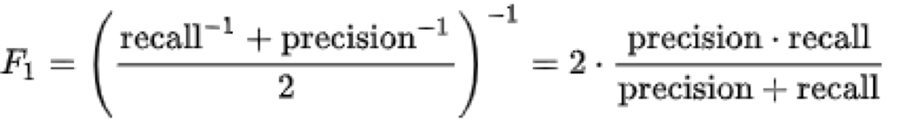
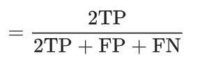
Evaluation Metrics: F1 Score
Harmonic mean of PPV (Precision) and TPR (Recall). Defined as follows:
Ranges from 0-1, as before
Balances extremes in PPV and TPR – must not change one to cheat the other
Notes:
Imagine a doctor ordering tests.
If they order too many unnecessary tests (low precision, high recall), they catch most sick patients but waste resources.
If they order too few tests (high precision, low recall), they rarely test healthy people, but they miss many sick ones.
The F1 score balances these extremes — it rewards a strategy that is both accurate in its positives and thorough in catching true cases.

Slide 42
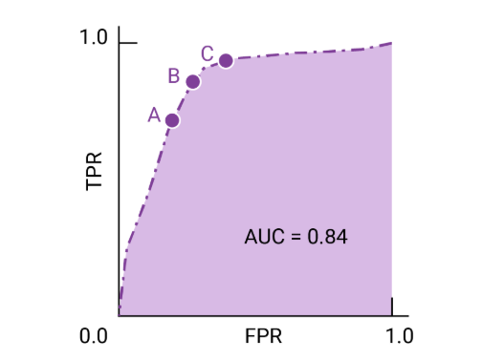
Evaluation Metrics: Receiver-operating characteristic curve (ROC)
Visual representation of model performance across all thresholds
The ROC curve is drawn by calculating the true positive rate (TPR) and false positive rate (FPR) at every possible threshold
Notes:
Represents tradeoff between true positives and false positives. It’s how sensitive we are to calling things positive. Depends on context exactly what we want to do.
Ex. If a disease is life threatening we want to maximize TPR even if we have high FPR. If opposite, only those that are definitely + to minimize cost.

Slide 44
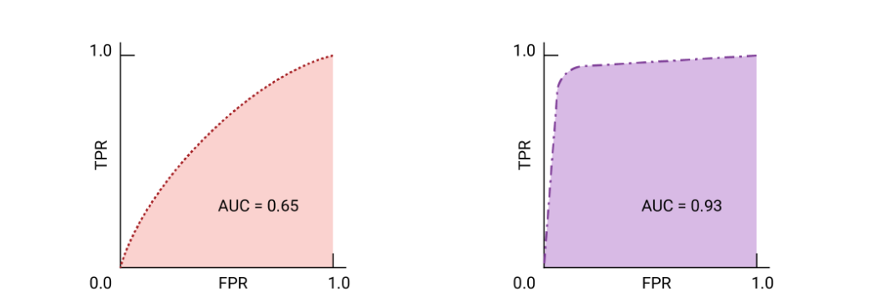
Evaluation Metrics: Area Under ROC

Slide 45
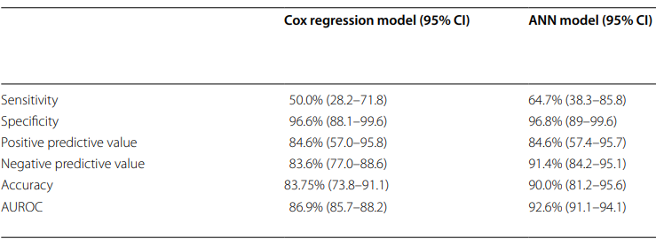
Back to Our Example
Notes:
ML wins in all categories here.

Slide 46
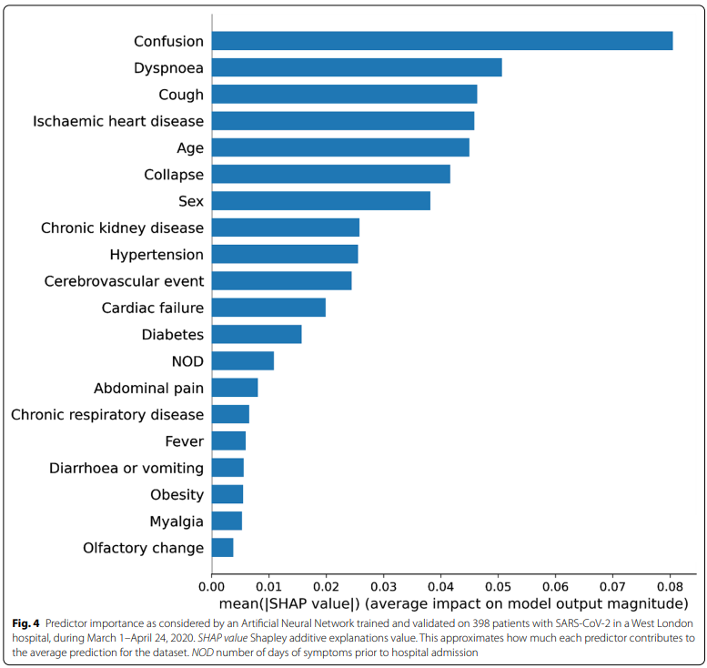
Notes:
Features that the model weighted highly when determining the classification – something we’ll discuss more in depth in another class.

Slide 47

Multi-Class Classification
What if we want to classify into more than two groups?
One vs all approach
One vs one approach
Define a “one hot” output vector where the vector at a given index is closer to one if there’s a higher probability of it actually being in that class.
Notes:
One approach is one vs all. We could train a network to predict “ in class one or not” then another “ in class 2 or not” etc etc.

Slide 48
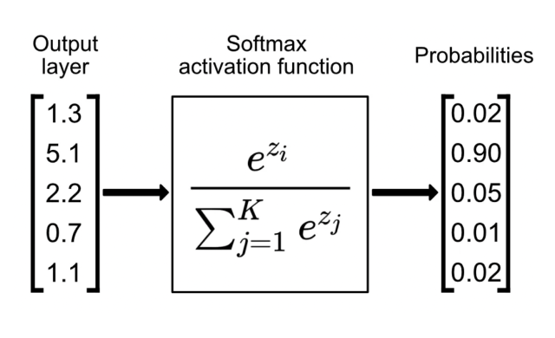
Softmax Function
Notes:
Note that it always adds to one across classes.

Slide 49
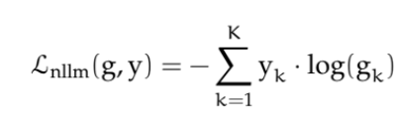
Multiclass Log Loss
For every class, multiply the log of the likelihood times if that is the true class.
If matches, probability approaches 1 and log is 0.
Extension of loss above.
Notes:
Check for yourself in the two case example – it’s the same.

Slide 50
Recap
Problem Type | Final Activation | Loss Function
Predicting a number | Linear or ReLU | Mean Squared Error
Classifying into one of two groups | Sigmoid | Log Loss (Cross Entropy)
Classifying into one of many groups | Softmax | Multiclass Log Loss
Other |  | Many more!
Notes:
Final activation and loss work together to help you determine how decisions are made
When we encounter new problems, we may need creative new loss functions to help us score our outputs

Slide 51
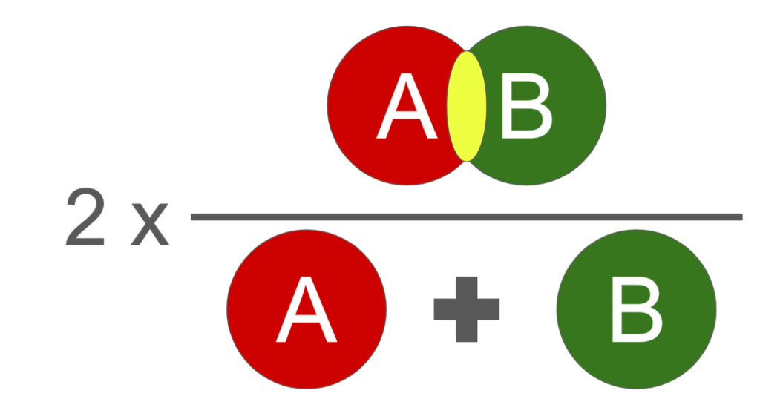
Preview: DICE Loss

Slide 52
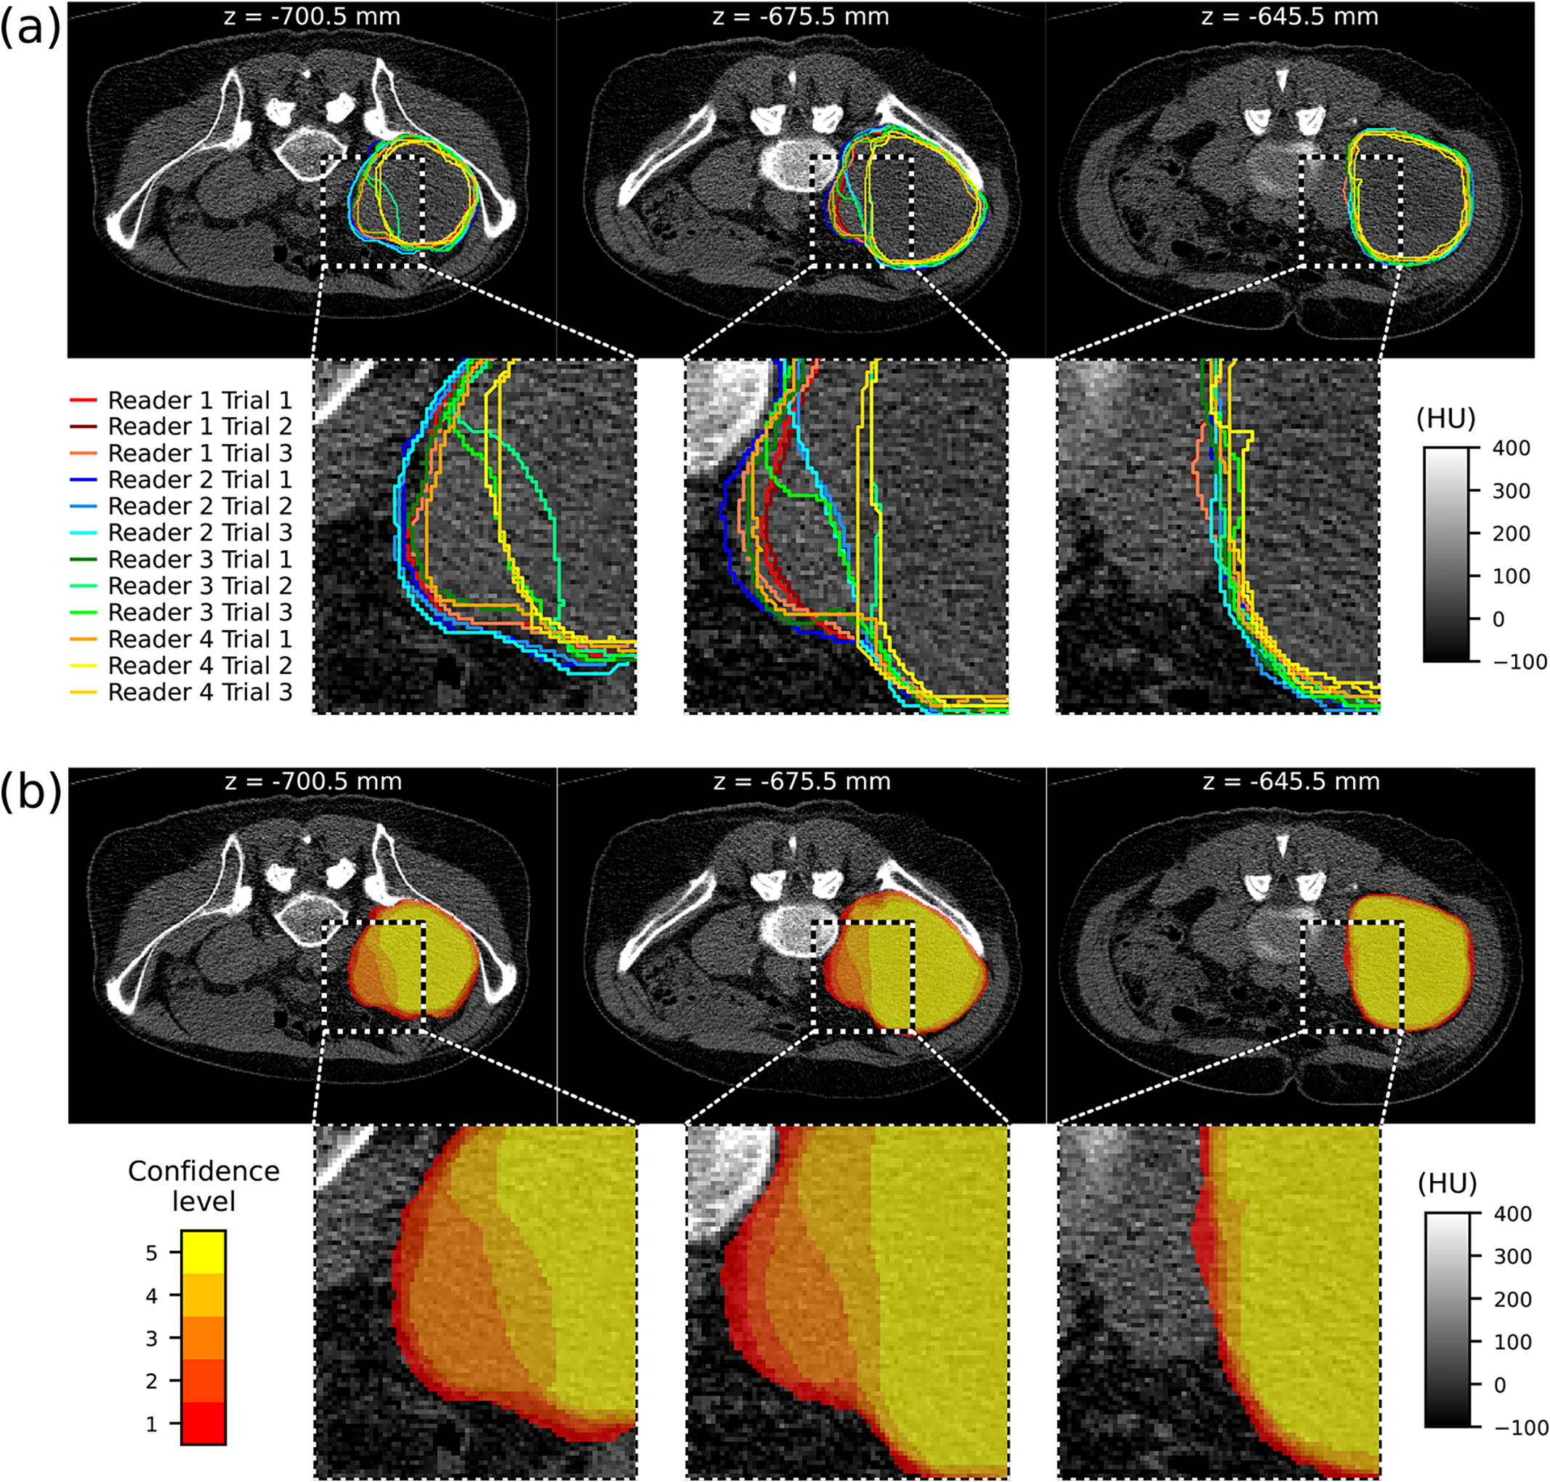

Slide 53
MNIST Classification

Slide 54
Thanks!

